Slide 1
Lominat Start here

Slide 2
MUM Schedule Project
Team Members:- Lominat Gebreselassie
- RanJan Bhusal
- Gebreselassie Kahsay

Slide 3
Project Description
Previously, MS in CS program, there were three entries per year and student entry numbers were 20-40 per entry. Often there was just one elective class being offered per block and all students in an entry took the same classes in the same sequence. Scheduling of classes and faculty was done with a relatively simple excel spreadsheet, and students were assigned to classes via a manual process.
As Compro has grown, MUM now offers 4 entries per year and there can be as many as 120 up to 130 students per entry. In some blocks, MUM may offer 8 or 9 elective classes, plus there are often 2 FPP classes and 2 MPP classes offered per entry.
There are several areas of specialization for classes such at Web Applications, Data Science, SW Design, and database classes …..etc.

Slide 4
Specialization : Most faculty have one or two areas of specialization and a set of classes that they would like to teach. In addition, they have preferences for what blocks they can teach.
- Faculty need to be able to update their profile and be able to view their scheduled classes.
- Students should be able to view the schedule and register for classes.
- Admin should be able to do CRUD operation of Students, Faculties, Courses, Sections etc…
Prerequisites : some 500 level courses have. 400 level course as prerequisites, so the 400 level courses should be offered for each entry in their first blocks on campus. The 500 level classes should be provided for their later blocks on campus. Most students take 4 elective blocks on campus. Whereas U.S. resident students may take 9 elective blocks on campus.
MUMSchedule intends to build a Compro schedule of classes with faculty assigned to each class and will also offer a simple tool for students to register for those classes

Slide 5
Technologies And Framework's Used :
FRONT END TECHNOLOGIES USED
Thymeleaf, HTML , CSS , Bootstrap, Spring MVC Framework
BACK END (business layer) TECHNOLOGIES USED
SPRING Hibernate as JPA Implementation
Spring Security
BACK END (database layer) TECHNOLOGIES USED
MYSQL DATABASE

Slide 6


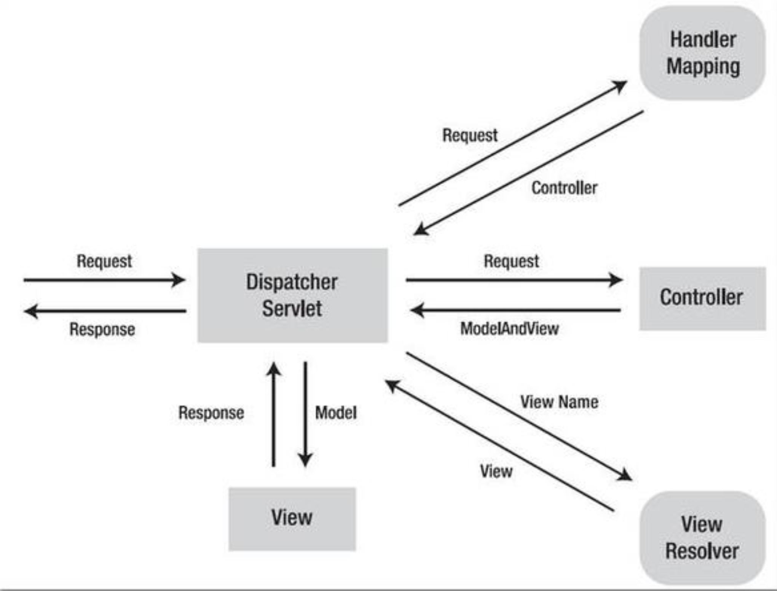

Spring MVC Architectural Design

Slide 7


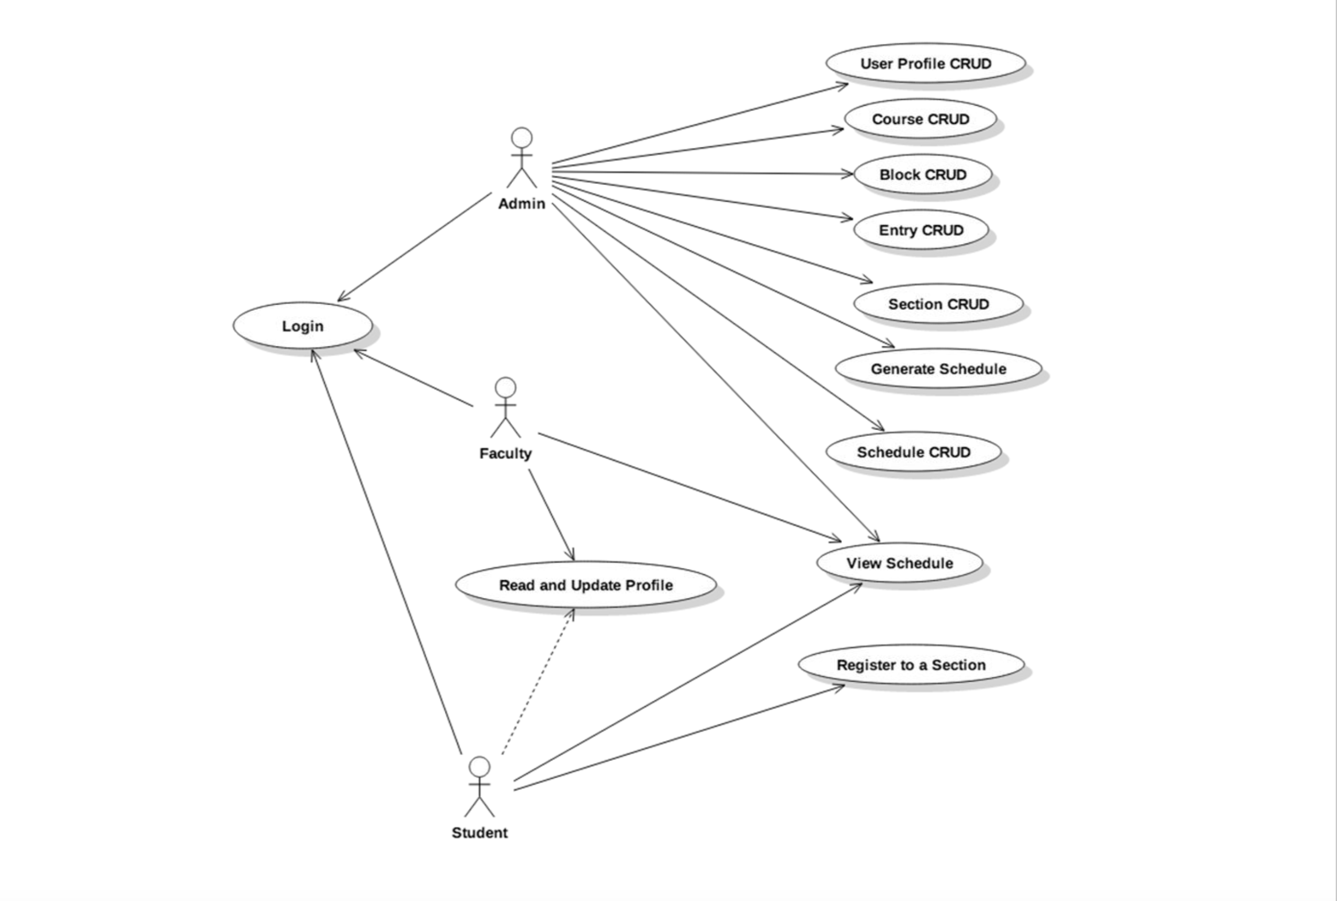

Use – Cases Diagram

Slide 8
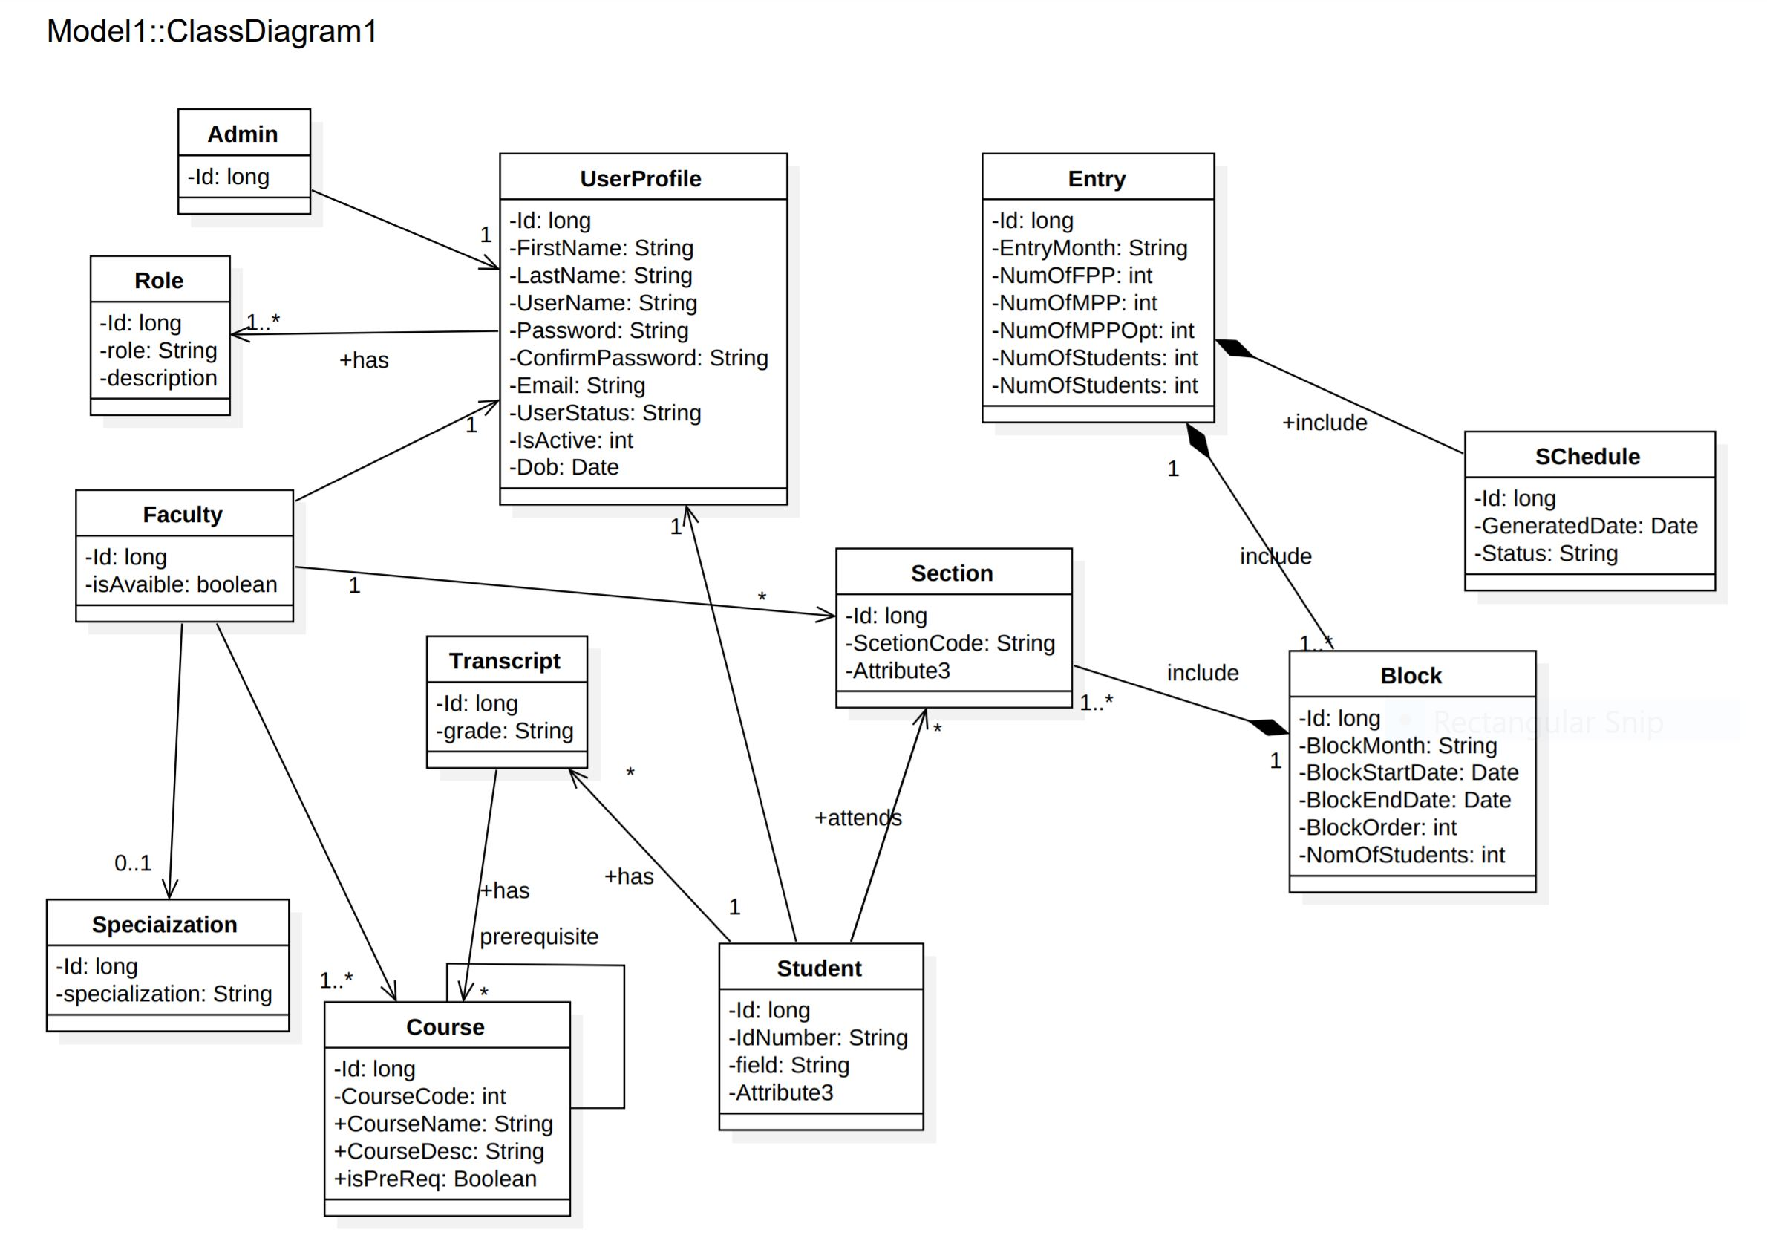
Main Class Diagram

Slide 9
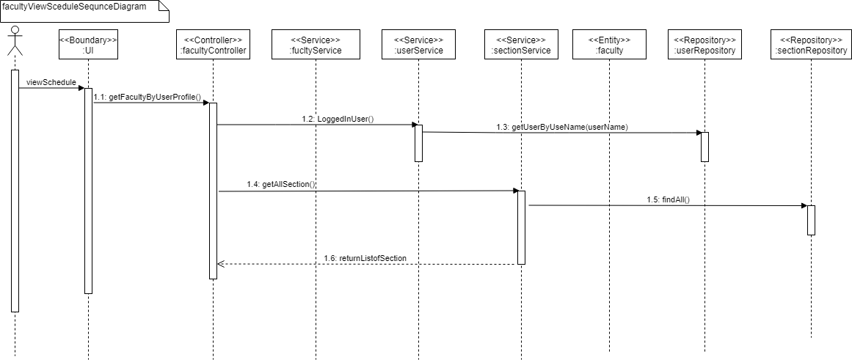
Faculty Sequence Diagram

Slide 10
Gebreselassie

Slide 11
Use Case Specification: Student can update their profile.
1. Brief Description:
- This use case allows a Student to update their profile.
2. Actors:
- Student
3. Preconditions:
- Student is logged in and at the view of student page.
4. Basic Flow

Slide 12
…cont
5. Post-Conditions:
- For the success basic flow, the new profile will be saved to the DB with updates.
6. Non-functional requirements:
- none
User Action | System Response
1. Student select update profile requests form the student page | 1. The system displays the form to edit the profile
2. The student edits his/her profile and request the system toe | 2. The system checks the student’s status and save the profile in to the data base

Slide 13
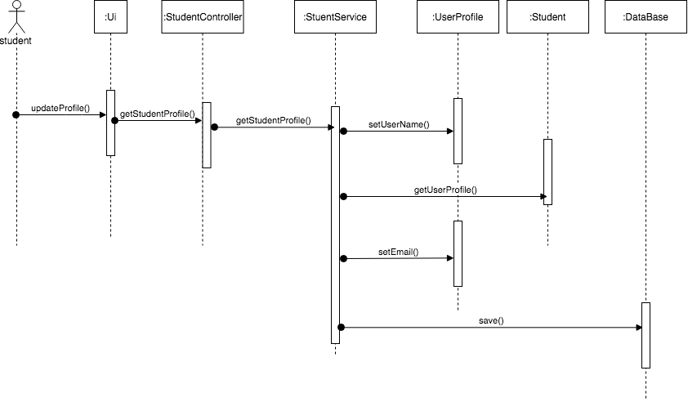
Sequence diagram for student to register

Slide 14
Use Case Specification: Register to a section
1. Brief Description
- This use case allows the Student to register to a Section.
2. Actors
- Student
3. Preconditions
- The Applicant has successfully completed request for a login
4. Flow of Events

Slide 15
…cont
4.1 Flow of Events
User Action | System Response
1. Student select “Register for section” | 1. Display a page with the option of available courses for each blocks with the no of available seats
2. Admin select three courses with priority from one to three for each blocks and click “submit” button | 2. check if all blocks are selected and display the selected courses with successful message. 3. save the information to the DB
6. Post- condition
- The courses for each block will be saved to the DB
7. Business Rules
- Un available section will not be display on the page for the student.
8. Nonfunctional Requirements
- None

Slide 16
Ranjan

Slide 17
1stUse Case Specification: C.R.U.D User Profile
1. Brief Description
- This use case allows the admin to create, read, update and delete the user profile.
2. Actors
- Administrator
3. Preconditions
- The Applicant has successfully completed request for a login
4. Flow of Events
4.1 Create New User Profile
- Basic flow
User Action | System Response
1. Admin select “User profile” | 1. Display a drop down page with the option of create new, read, update and delete Users.
2. Admin select “Create New User Profile” | 2. Display A form to be filled for basic information of the new user.
3. Admin fills all necessary information on the form and click submit button. | 3. verify all the information whether there is unfilled information and also verify if the password match. 4. Store all the information of the user to the DB and 5. Display “User Profile Created successfully message”

Slide 18
Alternate flow
i) Unfilled information on the form.
User Action | System Response
1. there was unfilled information on the form and the admin click submit button. | 1. Notify the Amin with a display that there is unfilled information on the form by showing which place needs to be filled by changing the filled place border to red color.
ii) the two entered password is unmatched.
User Action | System Response
1 Admin fill unmatched password on the two password filled when creating the new user profile | 1. Notify the Amin with a display that password entered doesn’t match by showing the password filled e border to red color.
Post- condition
A new user profile is created and added to the system DB.

Slide 19
Some Issues
We faced an issues like figuring out pom.xml configurations, identifying the relation between the entity classes and unable to minimize

